Slide 1

NFT Revenue Sharing
Determine the contributions of creating and spreading digital assets that later become profitable NFTs from other content creators, such as:
Celebrity social media accounts.
Company and Brand social media accounts.
Individual fans’ social media account.
NFTs ensure the original content creator gets certain percentage of the revenue cut:
DL analyzes social media engagements from all parties, including overall NFT profit and/or ad revenue data.
The NFT profit and resulting ad are distributed among the involved parties based on the contribution calculated from the analysis.

Slide 2
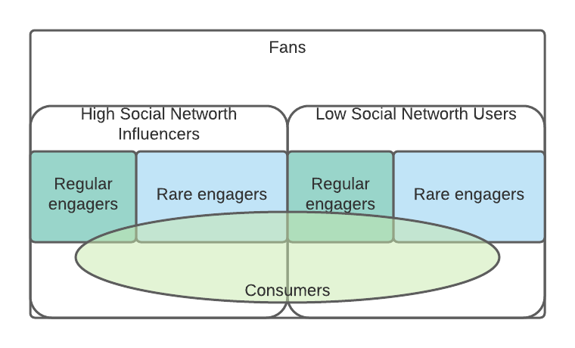
Promoting the NFTs / Fan based Advertising strategy
Based on the fans’ social media historical data, DL AI can determine:
Which fans to leverage to make the NFTs/Ads generate more buzz
Which fans to sell to in order to generate more NFTs/Ad revenue

Slide 3
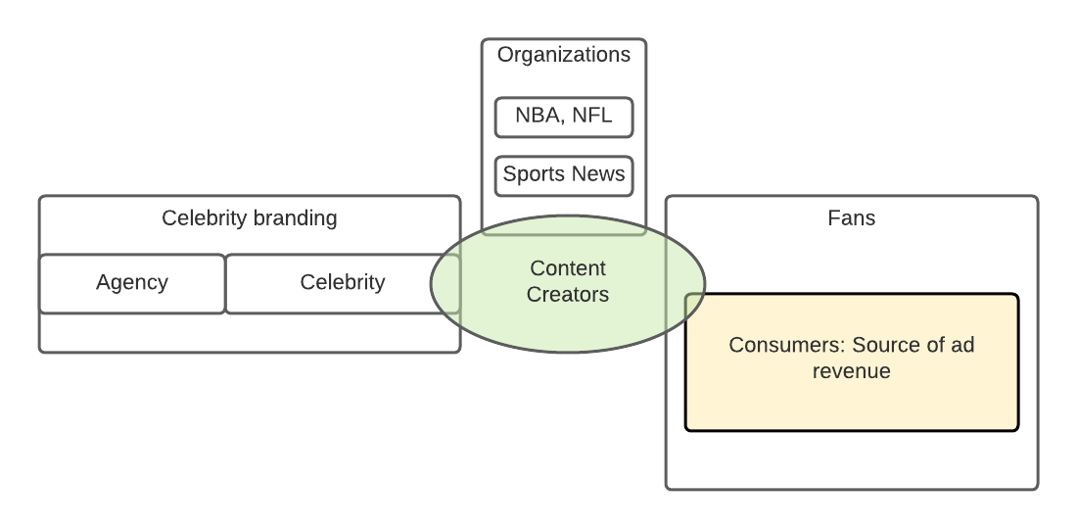
Non-sports Entertainment Figures
All parties involved in creating/spreading valuable digital assets/NFTs; these parties could overlap. The relationship between these parties are explained in the graph
Agency
Celebrity
Fans
Consumers
Social media content creators

